Slide 1
Indian Menu Project: Reading and Analyzing CSV Files
Submitted To: Tushar Sir
Submitted by: Kushank Jain
2210990534

Slide 2
Introduction
This project focuses on utilizing Python to read and analyze CSV files.
CSV files are a common format for storing tabular data, and Python provides powerful tools for working with them.
The project aims to demonstrate how Python can be used to extract, manipulate, and analyze data from CSV files.
By the end of the project, you will have a solid understanding of how to read and analyze CSV files using Python.

Slide 3
Reading CSV Files
CSV (Comma Separated Values) files are a common format for storing tabular data. Python provides several libraries for reading and analyzing CSV files, such as the built-in csv module and third-party libraries like pandas and numpy.
To read a CSV file using Python, you can follow these steps:
Import the necessary libraries.
Open the CSV file using the open() function.
Create a CSV reader object using the appropriate library.
Iterate over the rows of the CSV file and process the data as needed.
Close the CSV file.

Slide 4
Import the Necessary Libraries
Before reading a CSV file, you need to import the appropriate libraries. For the built-in csv module, you can import it using the following code:
import csv
If you are using third-party libraries like pandas or numpy, you will need to install them first and then import them using the following code:
import pandas as pd import numpy as np

Slide 5
Open the CSV file
To open a CSV file, you can use the open() function and specify the file path. For example:
with open('data.csv', 'r') as file: # Code to read the file
Make sure to replace 'data.csv' with the actual file path.
Create a CSV reader
Once the CSV file is open, you can create a CSV reader object using the appropriate library. For example, using the csv module:
reader = csv.reader(file)
Process the data
You can then iterate over the rows of the CSV file and process the data as needed. For example, you can use a for loop to iterate over the rows and print each row:
for row in reader: print(row)
Close the CSV file
After you have finished reading and processing the CSV file, it is important to close the file using the close() method. For example:
file.close()
Closing the file ensures that any resources associated with the file are properly released.

Slide 6
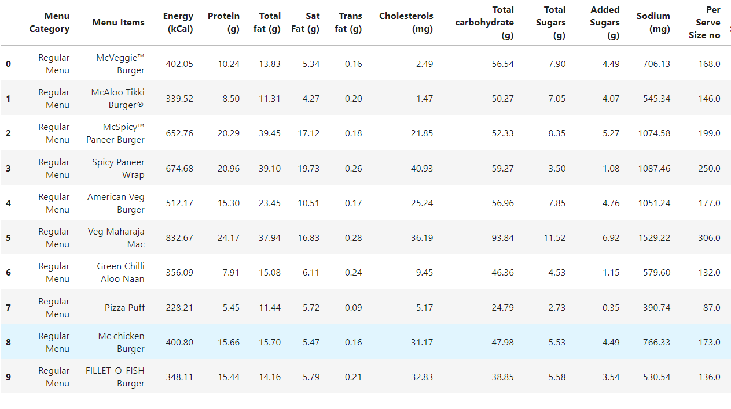
Key Variables
We got to know about the amount of fats, carbohydrates, sugar, sodium etc. present in that food item present in the menu like shown in the table given below:

Slide 7
Conclusion
Python provides powerful tools for reading and analyzing CSV files.
By using Python's built-in libraries such as Pandas and NumPy, we were able to easily manipulate and analyze the data.
Through this project, we gained valuable insights into the data, including trends and patterns that can inform decision-making.
Moving forward, we can leverage the skills and knowledge gained from this project to tackle more complex data analysis tasks.

Slide 8


